Slide 1
County Affiliate Setup
Apply for an EIN
This should be completed by the County Affiliate Chair, Secretary or Treasurer
This will need to be completed before opening a bank account

Slide 2
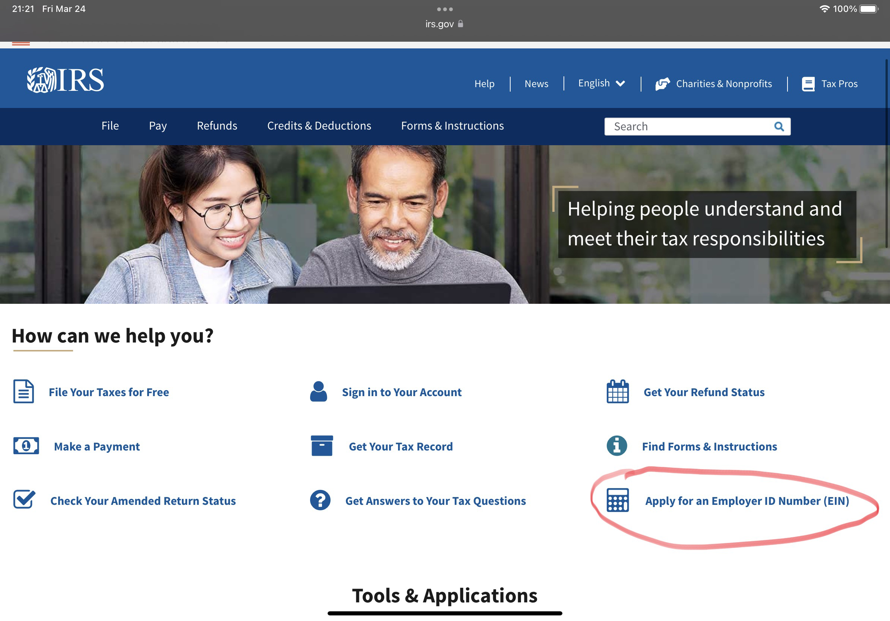
Visit IRS.gov
Click Apply for an Employer ID Number (EIN)

Slide 3
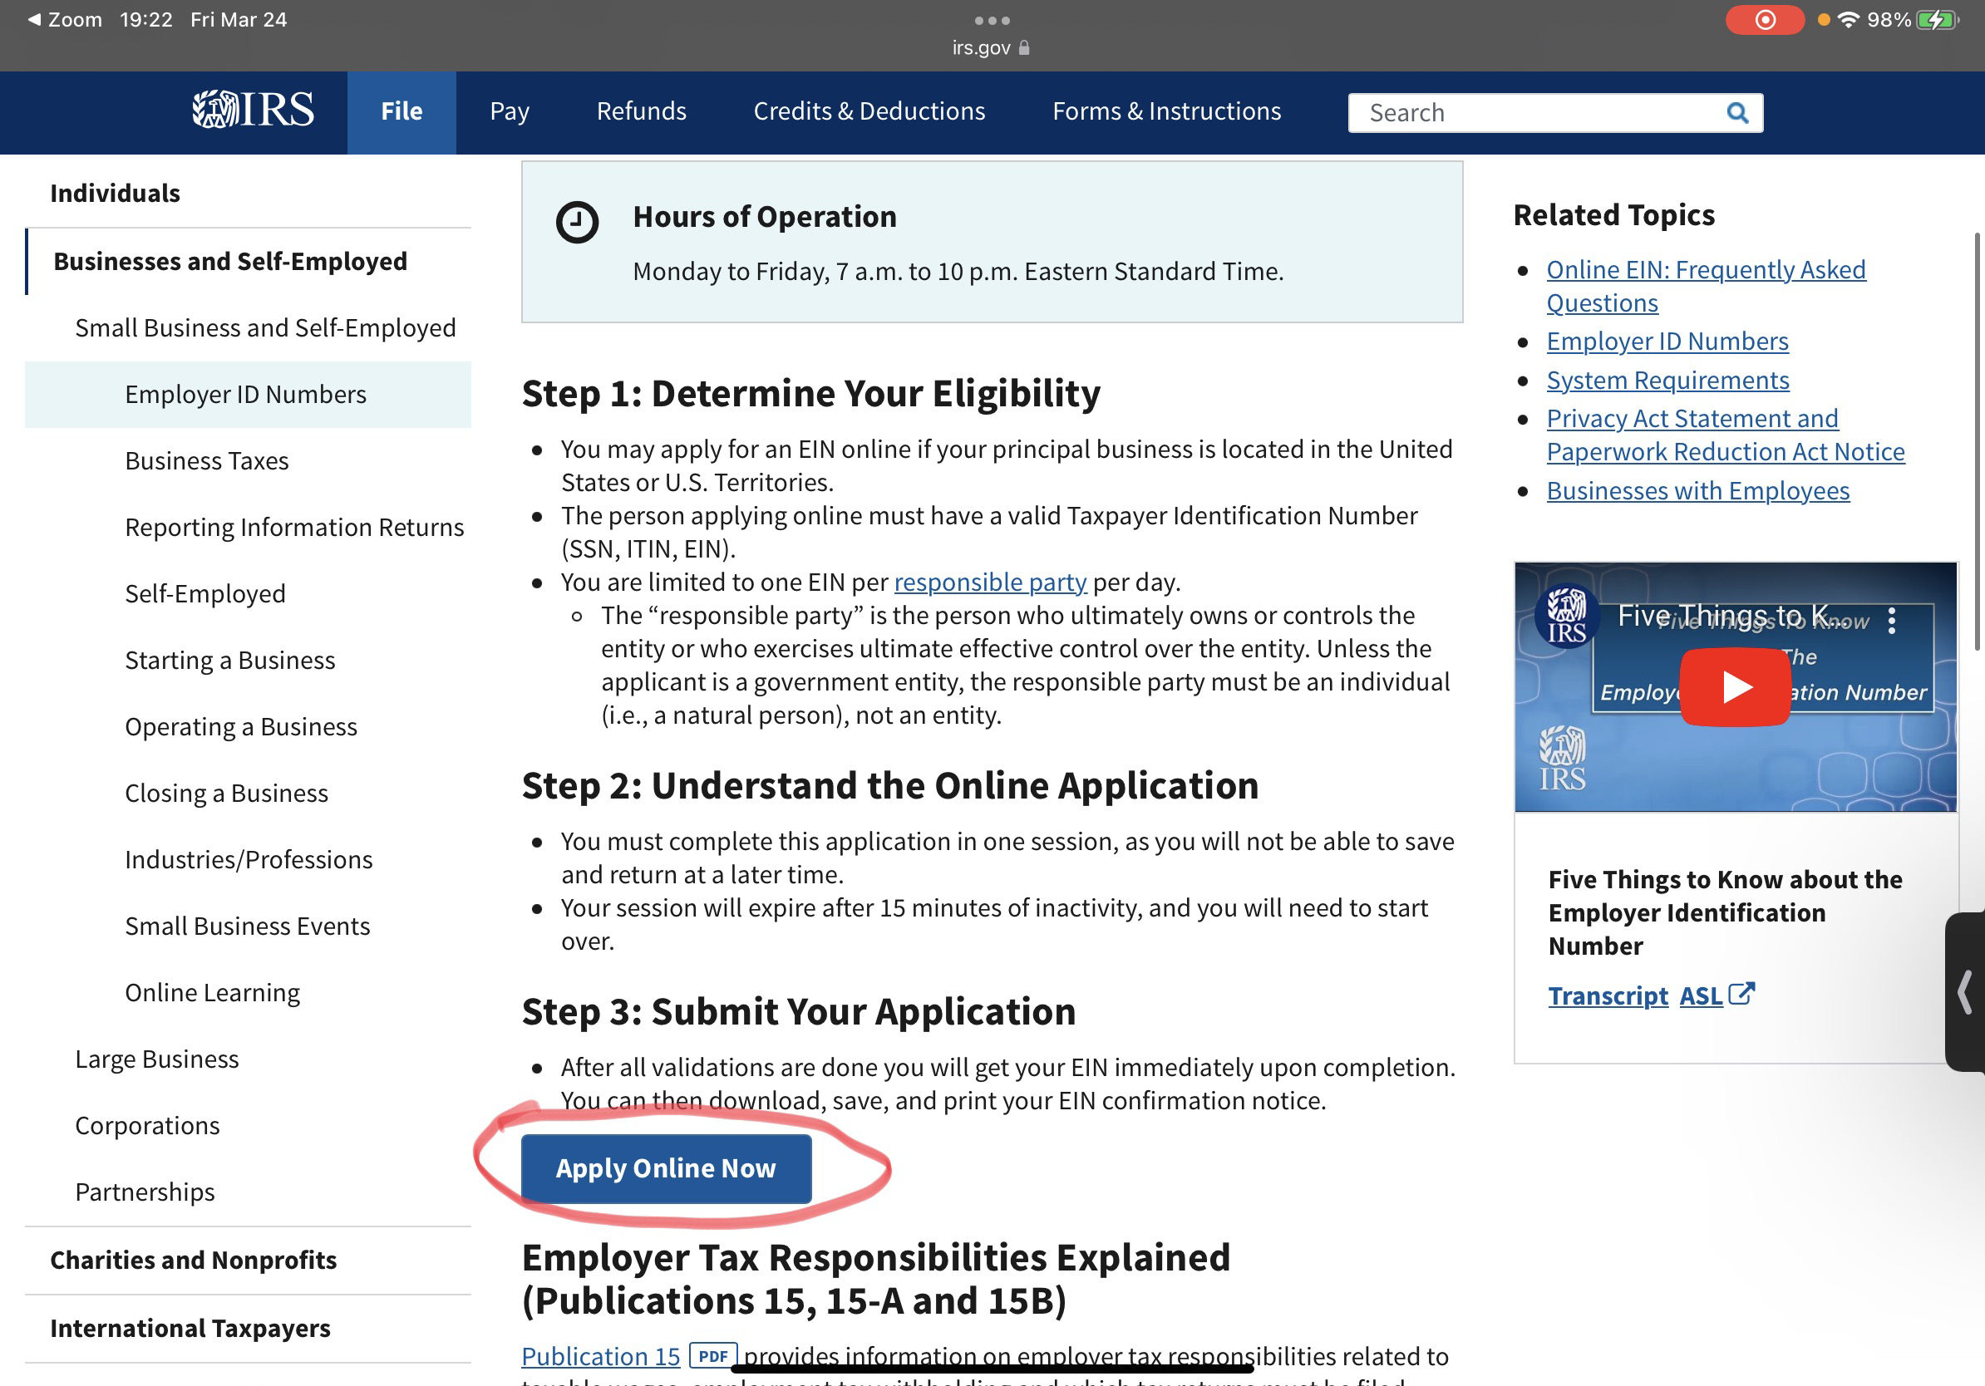
Click Apply Online Now

Slide 4
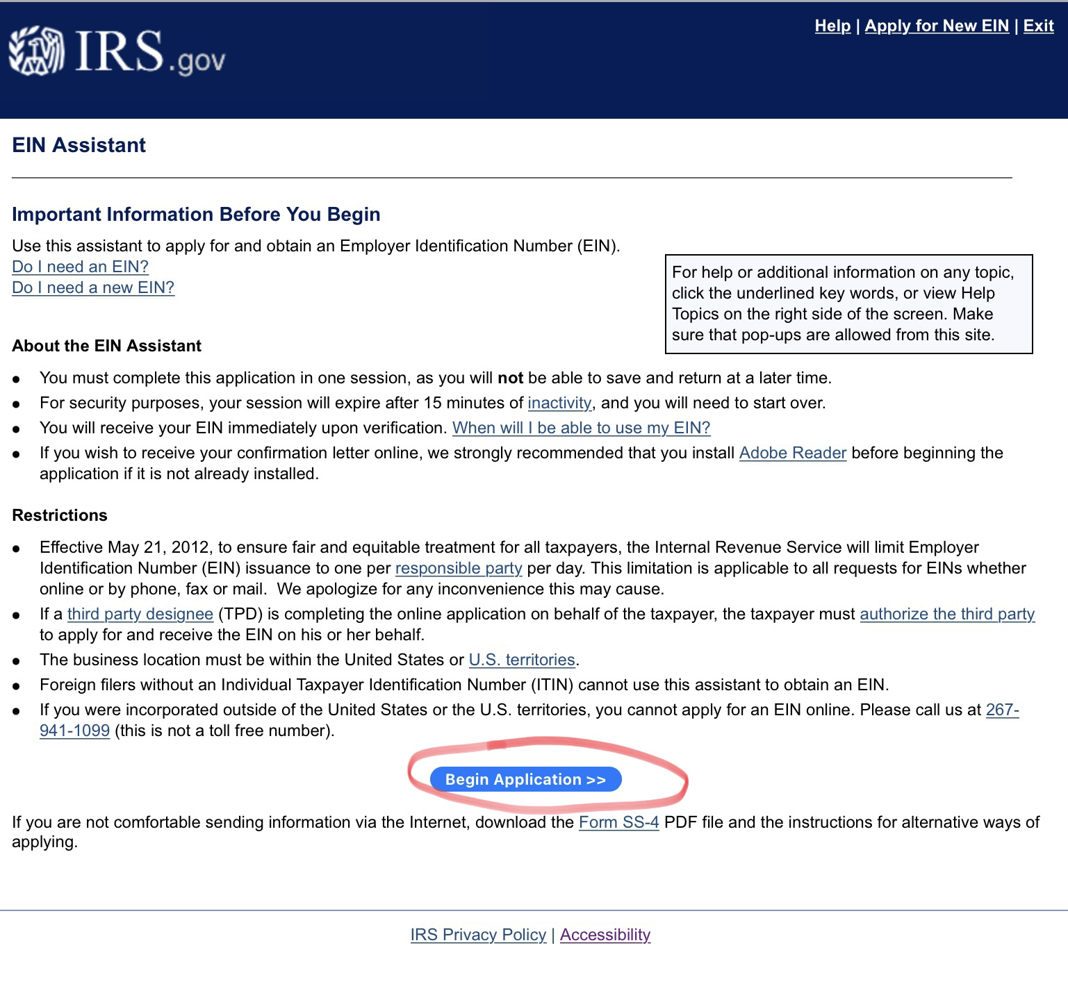
Click Begin Application

Slide 5
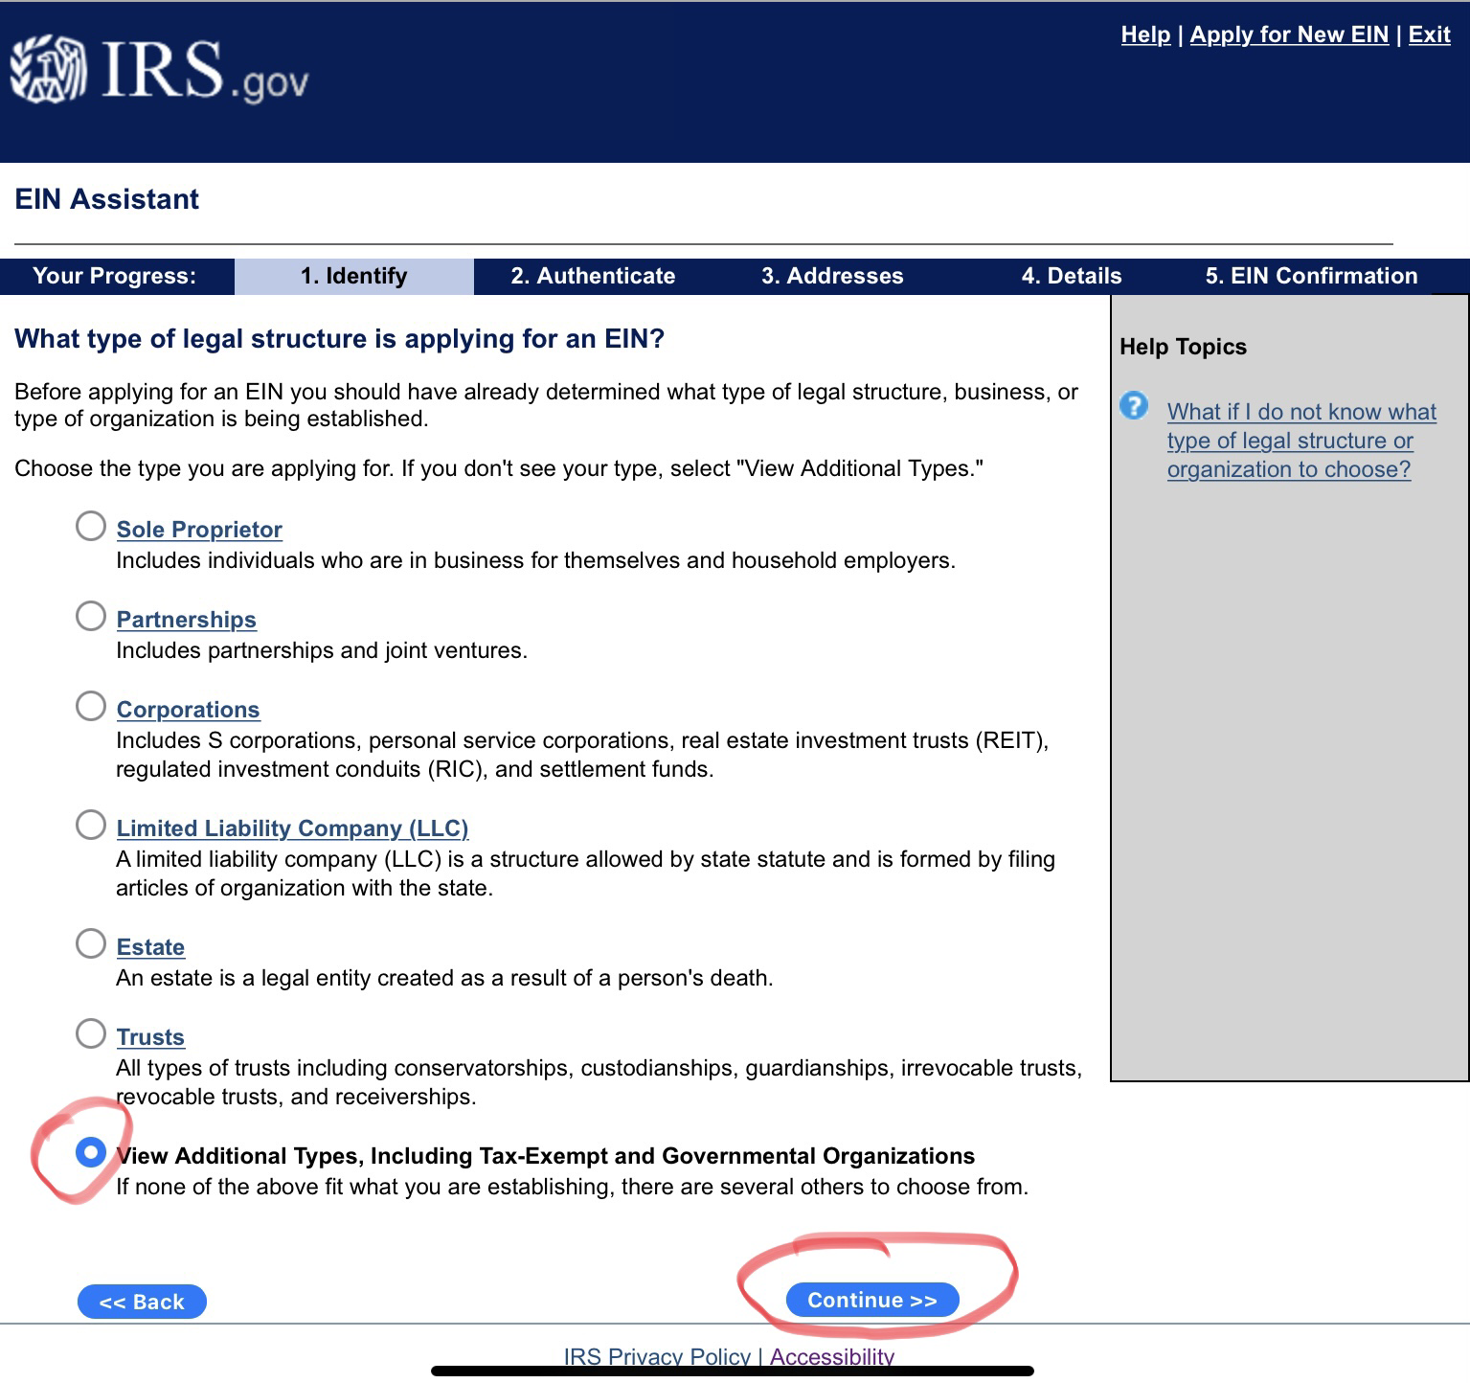
Select View Additional Types, Including Tax-Exempt and Government Organizations
Click Continue

Slide 6
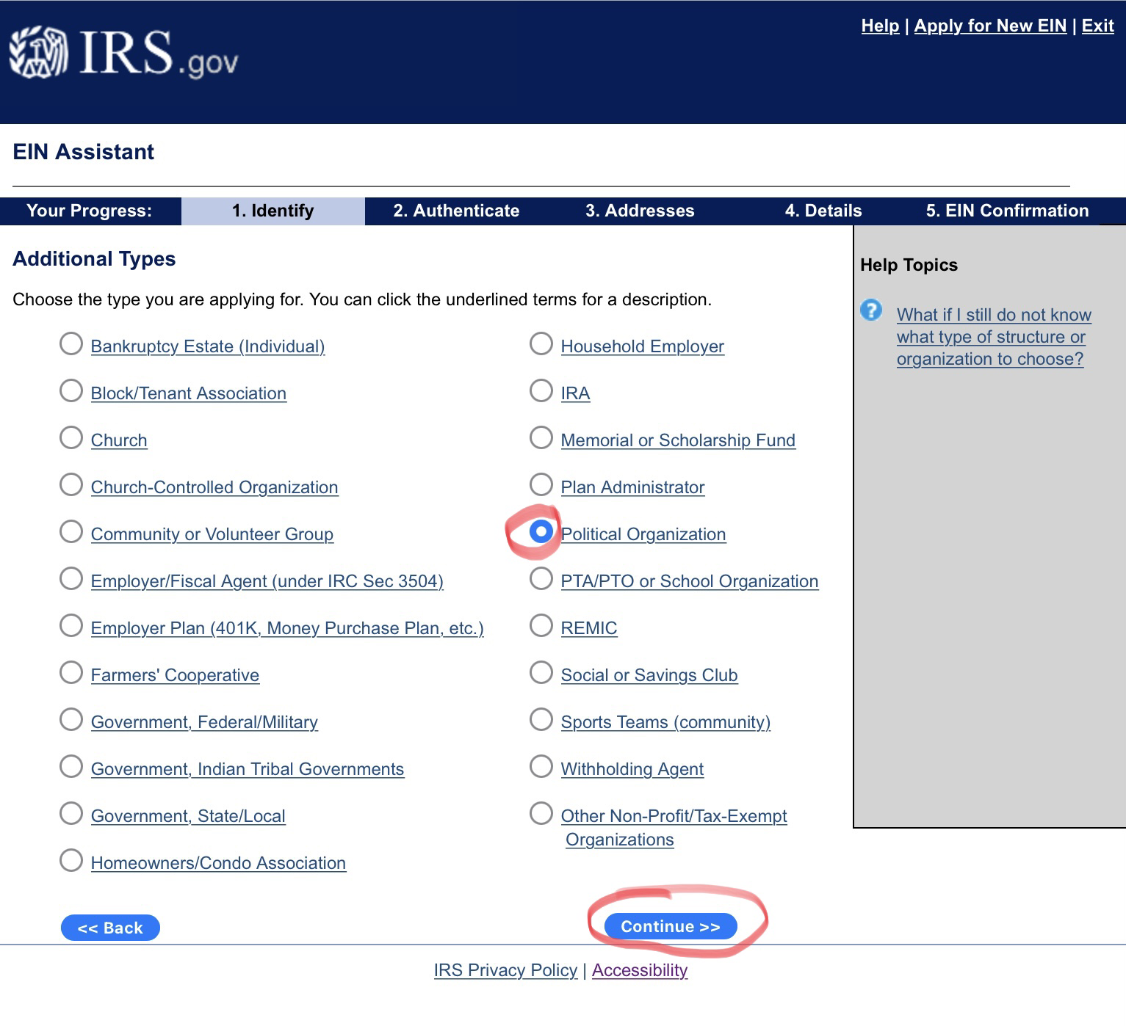
Select Political Organization
Click Continue

Slide 7
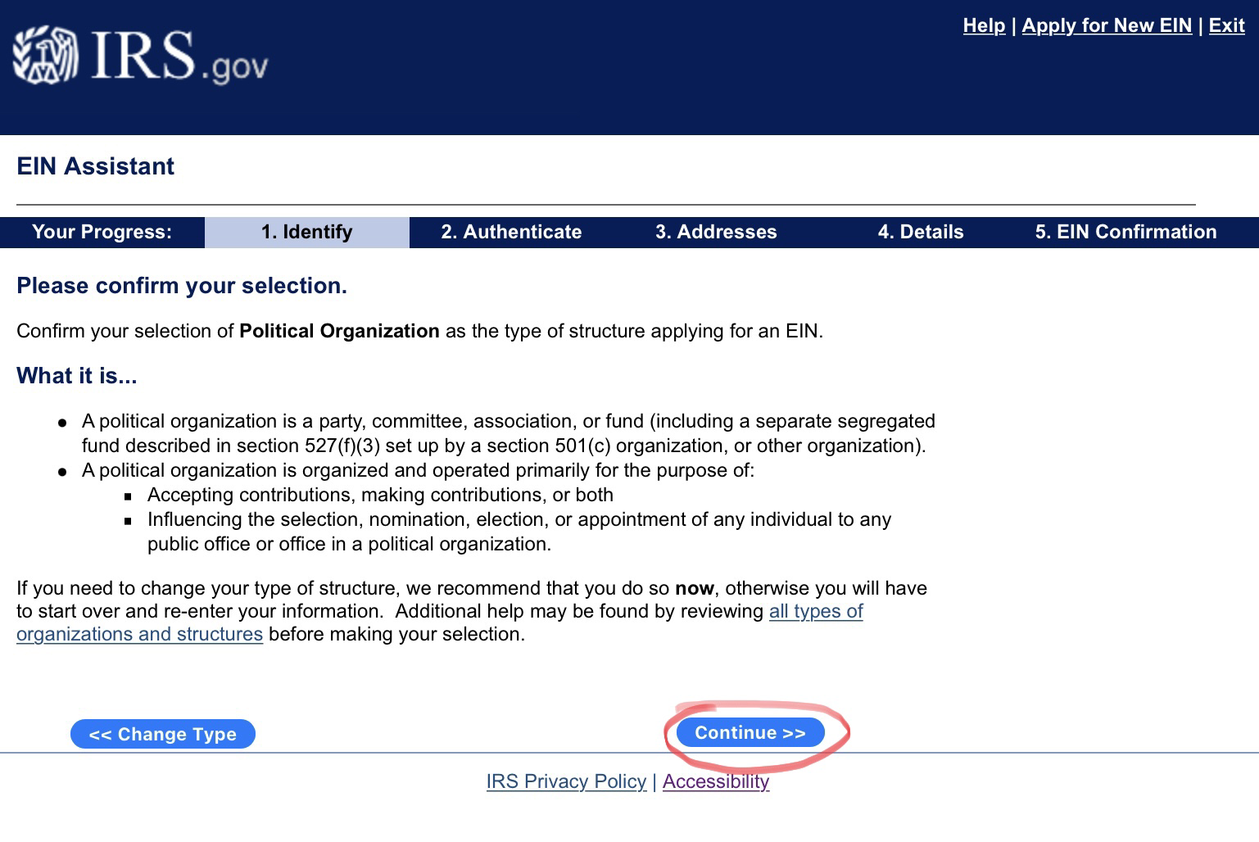
Click Continue

Slide 8
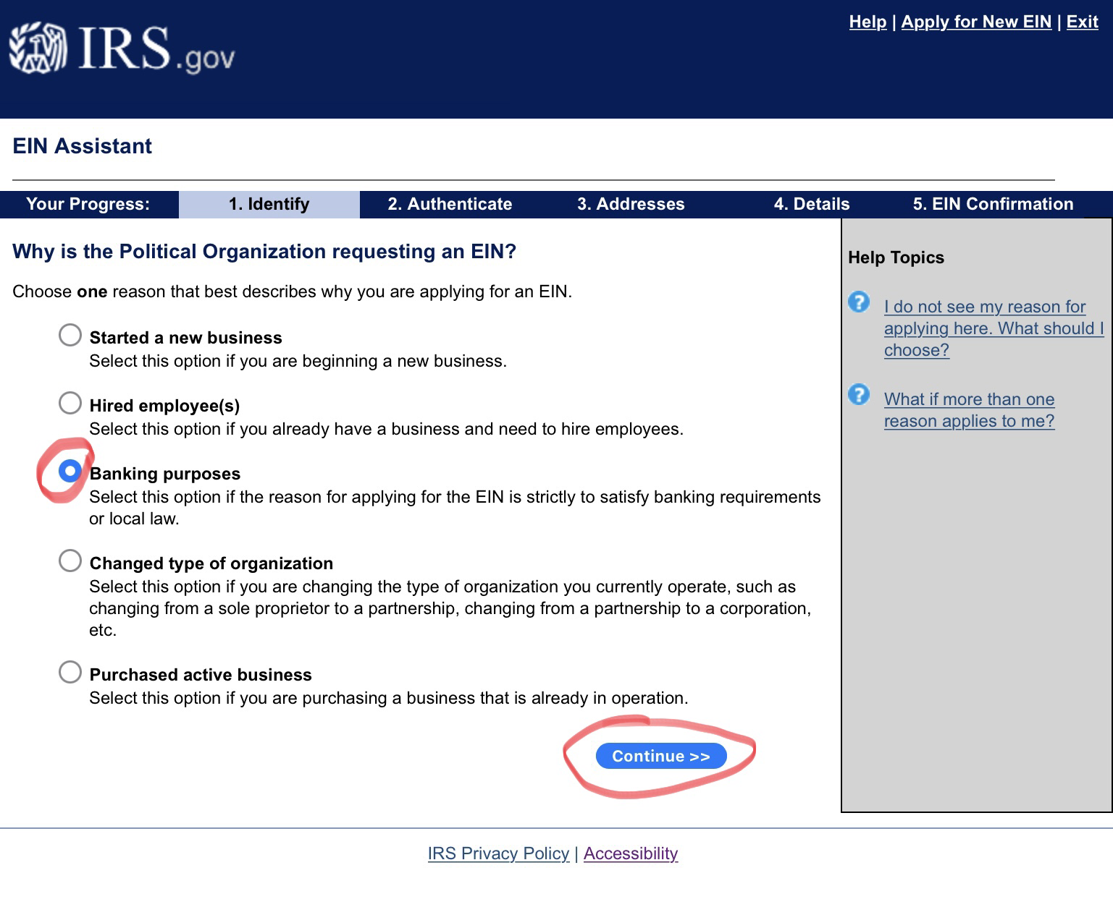
Select Banking purposes
Click Continue

Slide 9
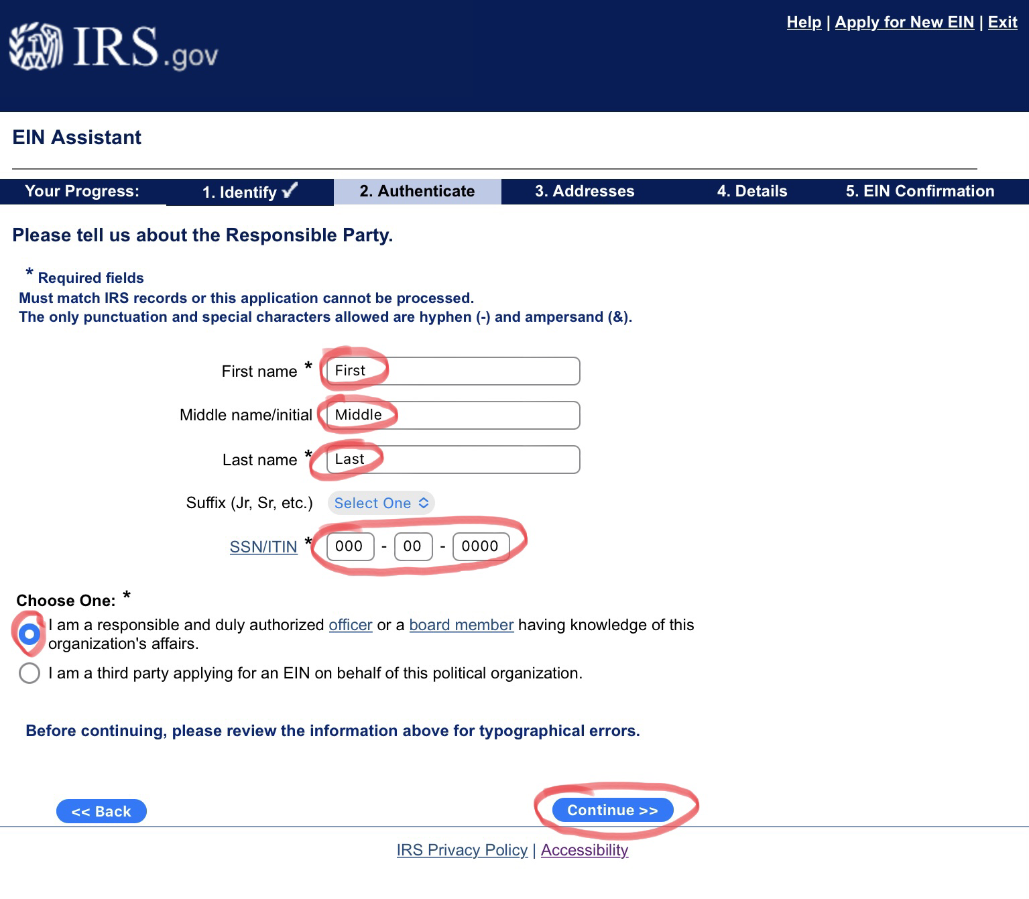
Type First Name
Type Middle Name
Type Last Name
Type SSN
Select I am a responsible and duly authorized officer or a board member having knowledge of this organization’s affairs.
Click Continue

Slide 10
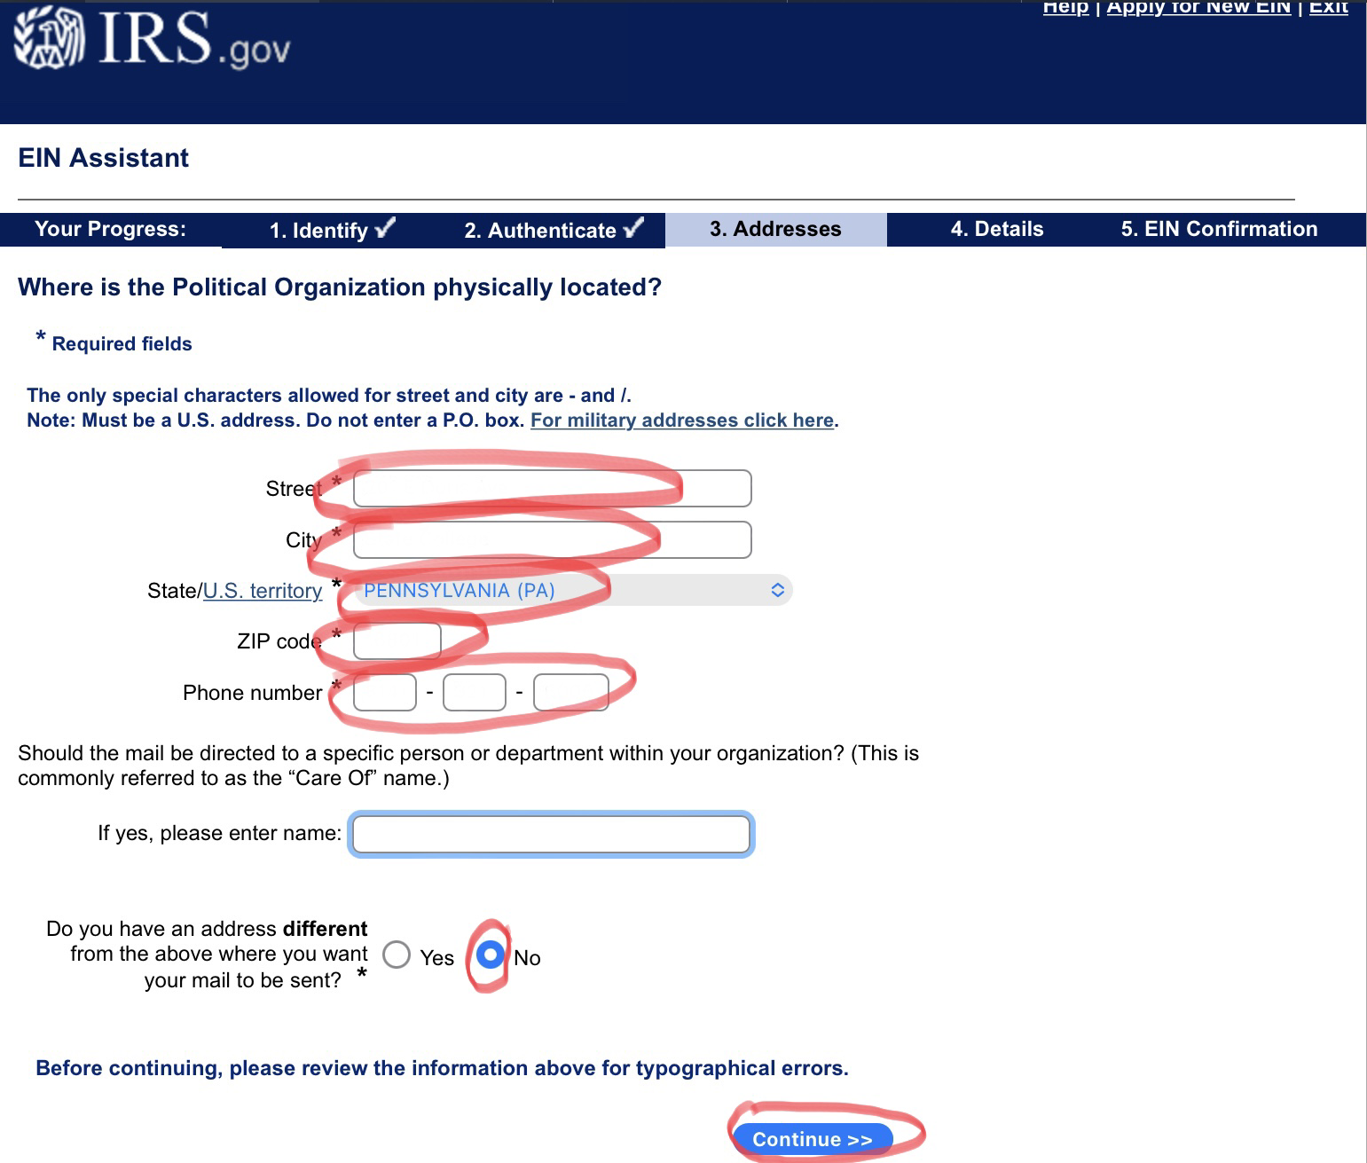
Type Street Address
Type City
Select Pennsylvania
Type ZIP code
Type Phone Number
Select No
Click Continue

Slide 11
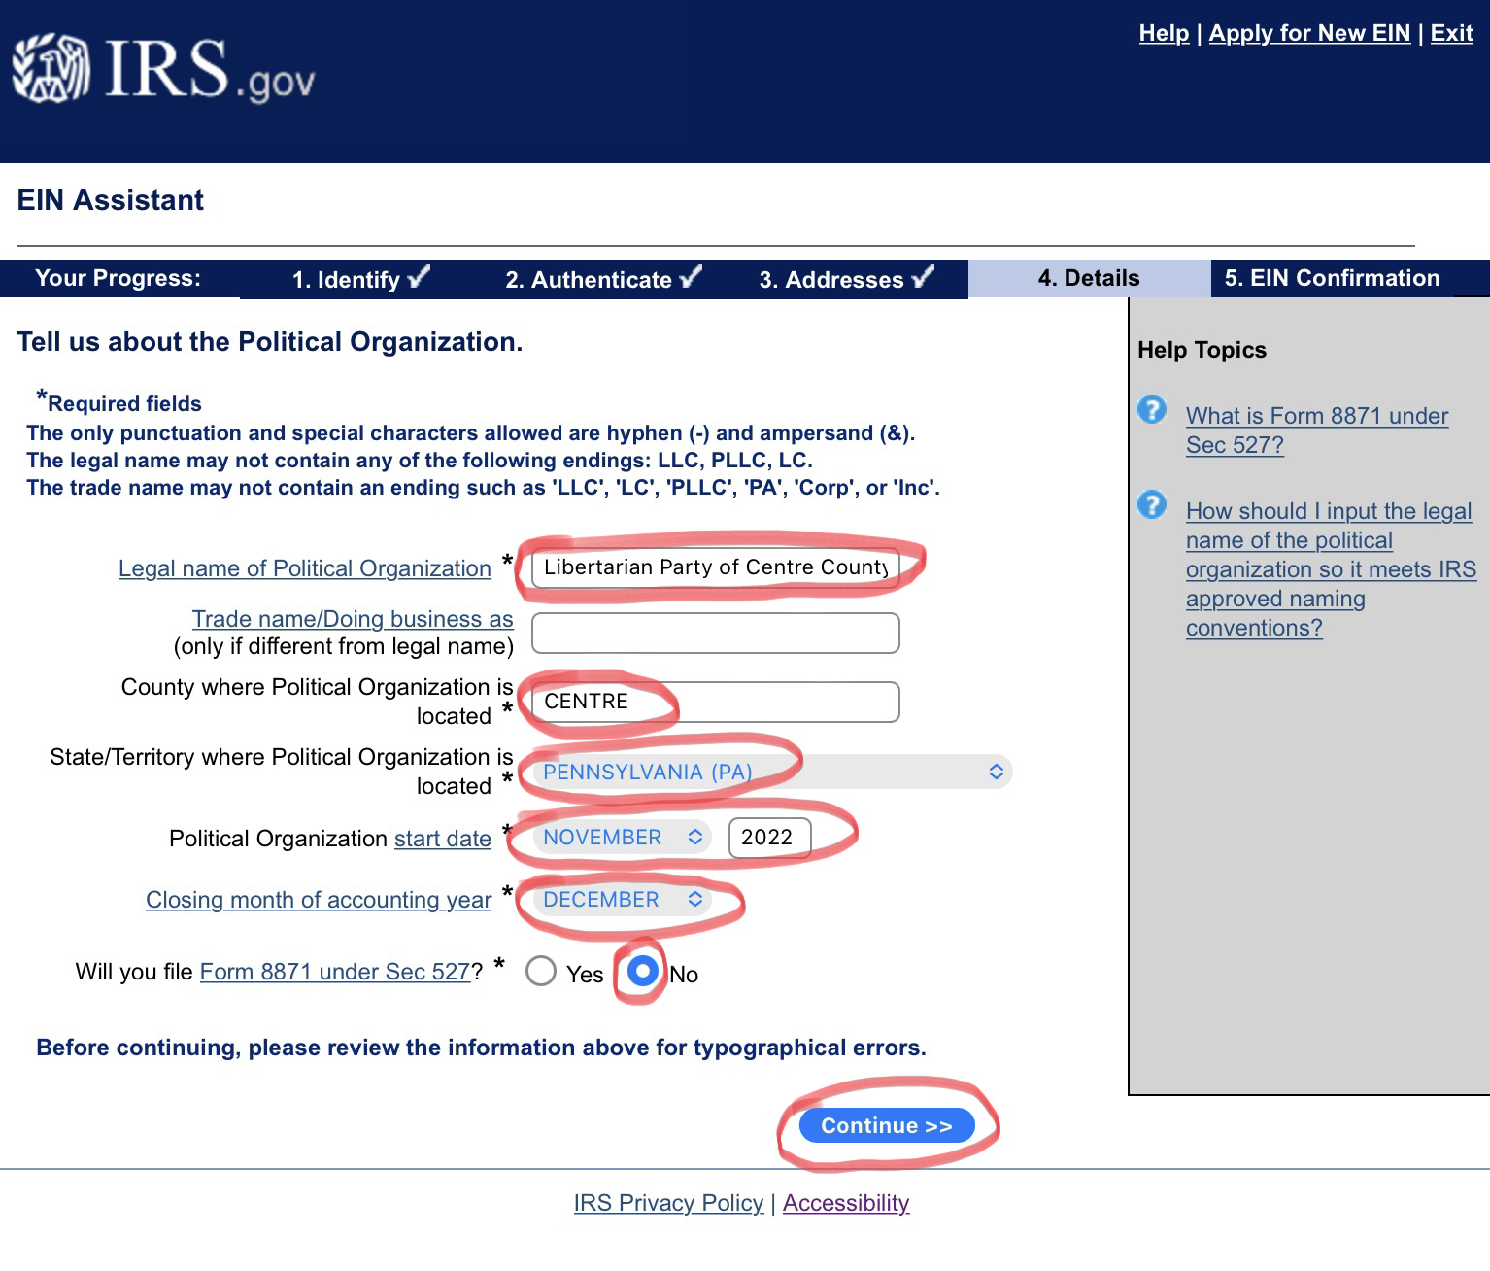
Type Legal Name of Political Organization
Type County
Select Pennsylvania
Select Start Date
Select December
Select No
Click Continue

Slide 12
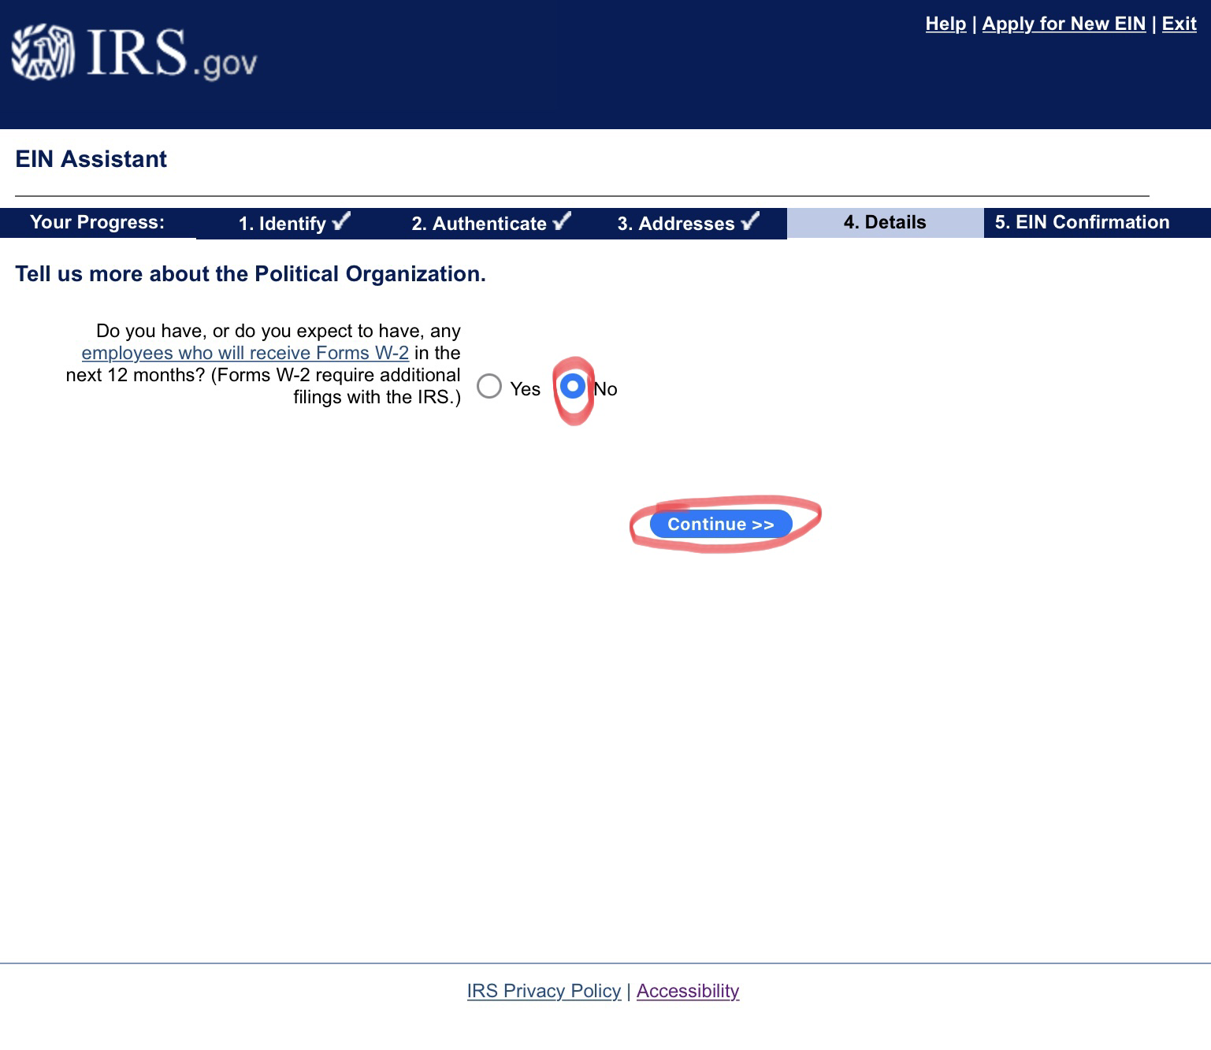
Select No
Click Continue

Slide 13
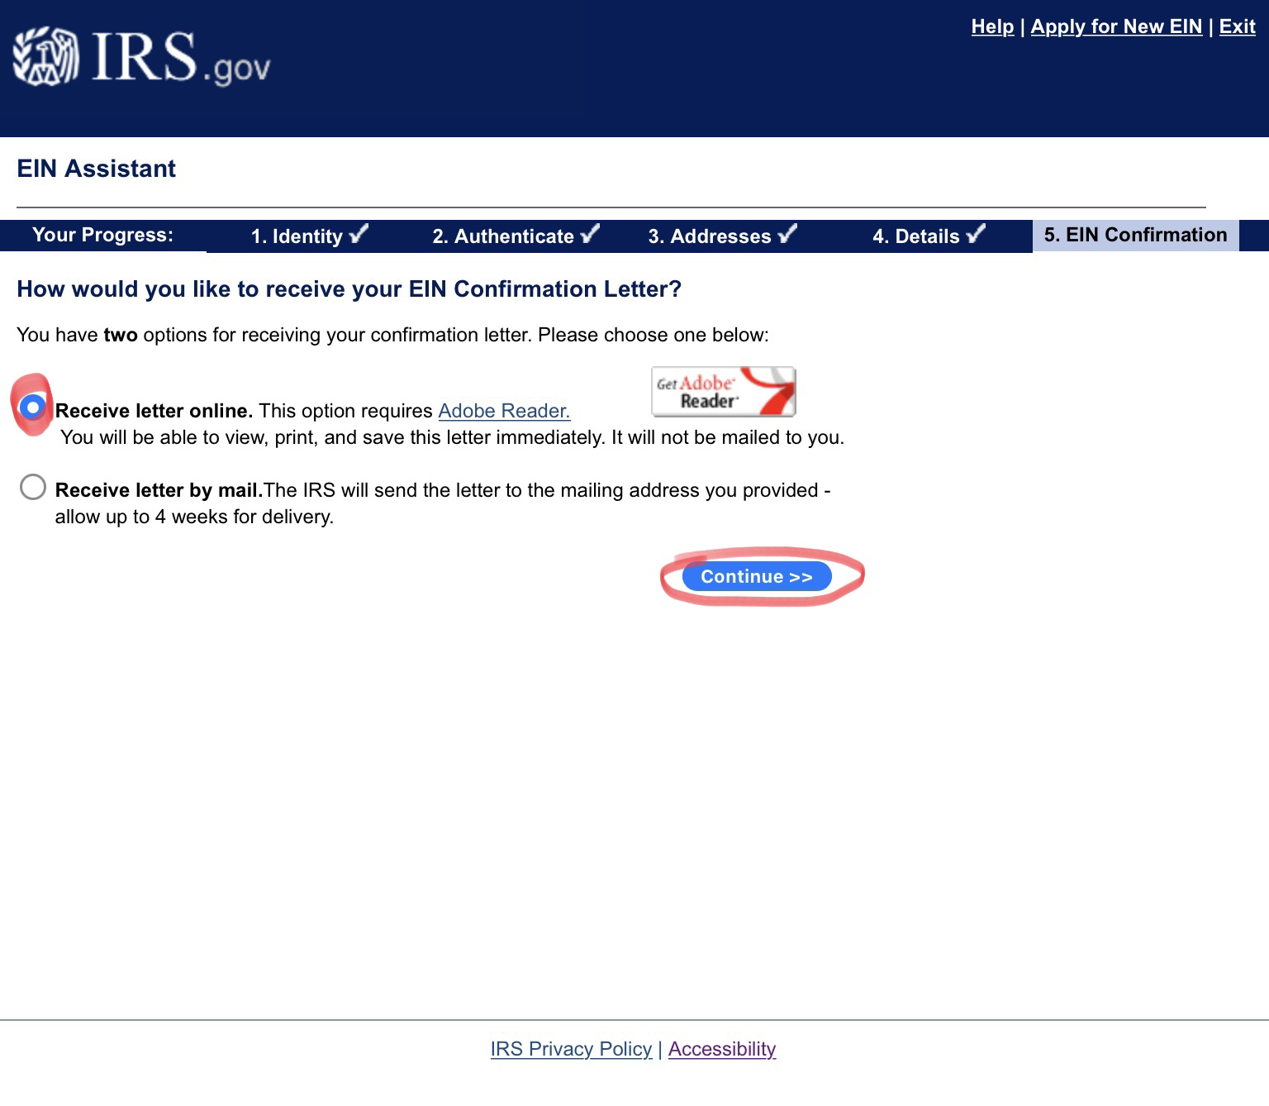
Select Receive letter online
Click Continue

Slide 14
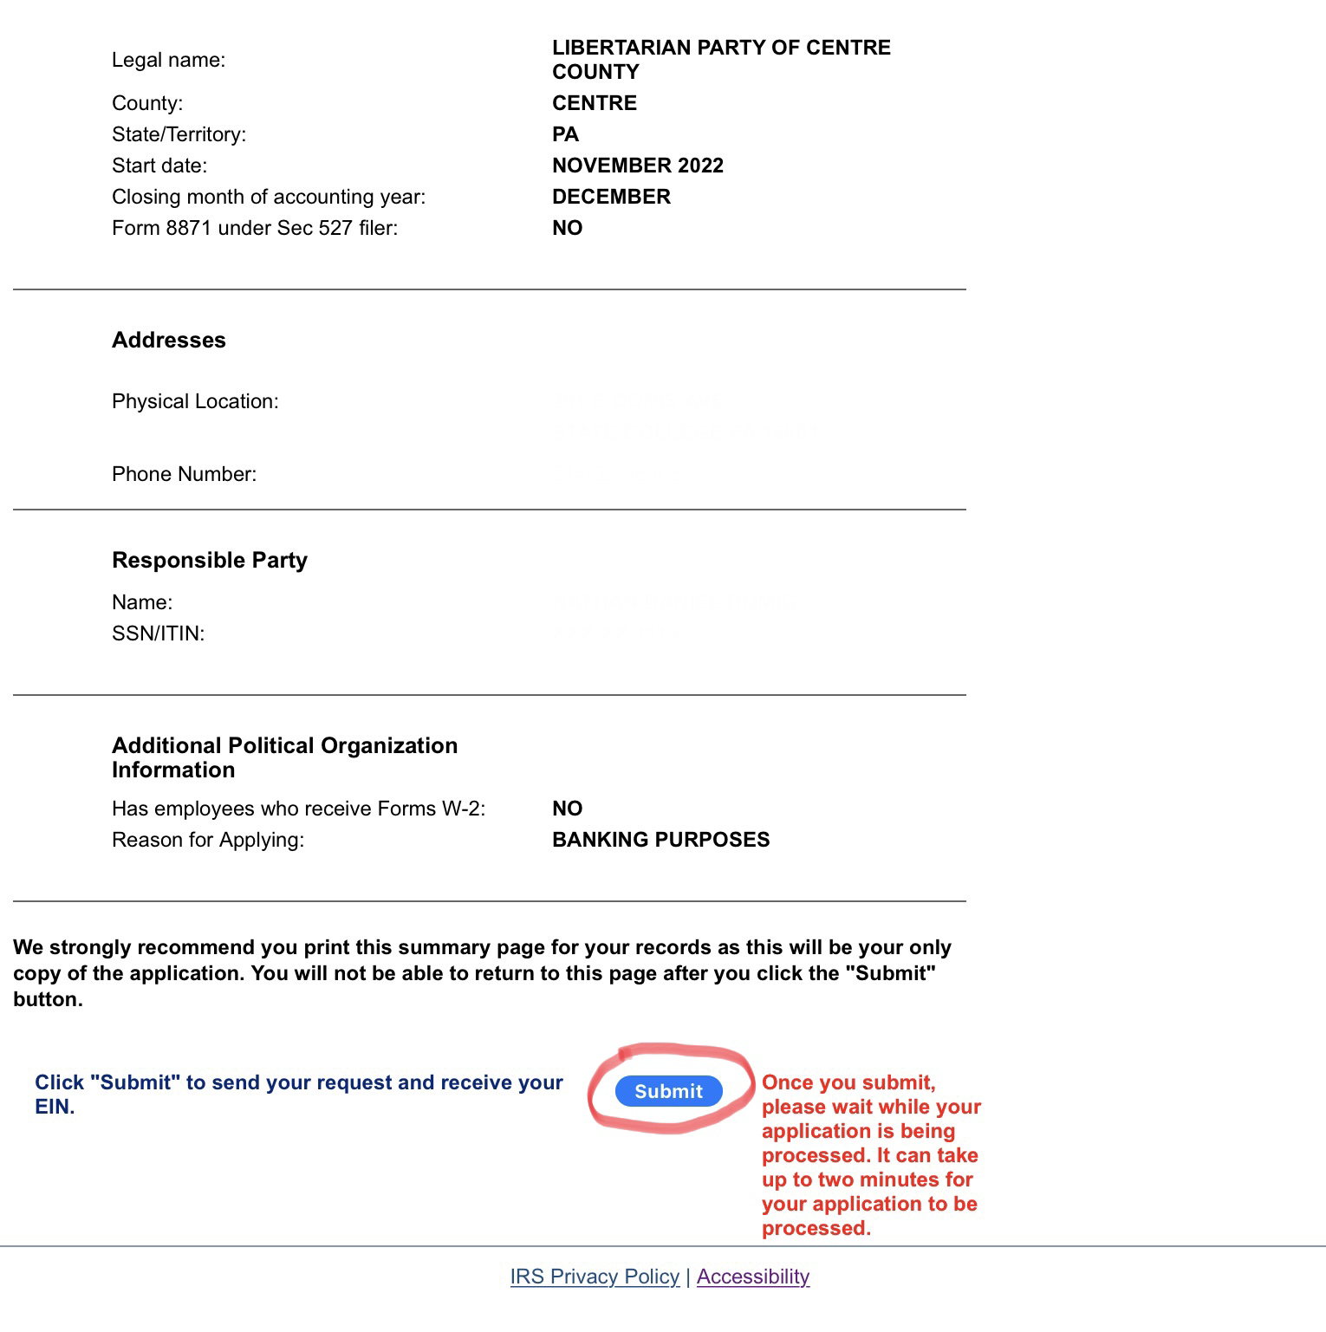
Review information for errors
Click Continue if all correct

Slide 15
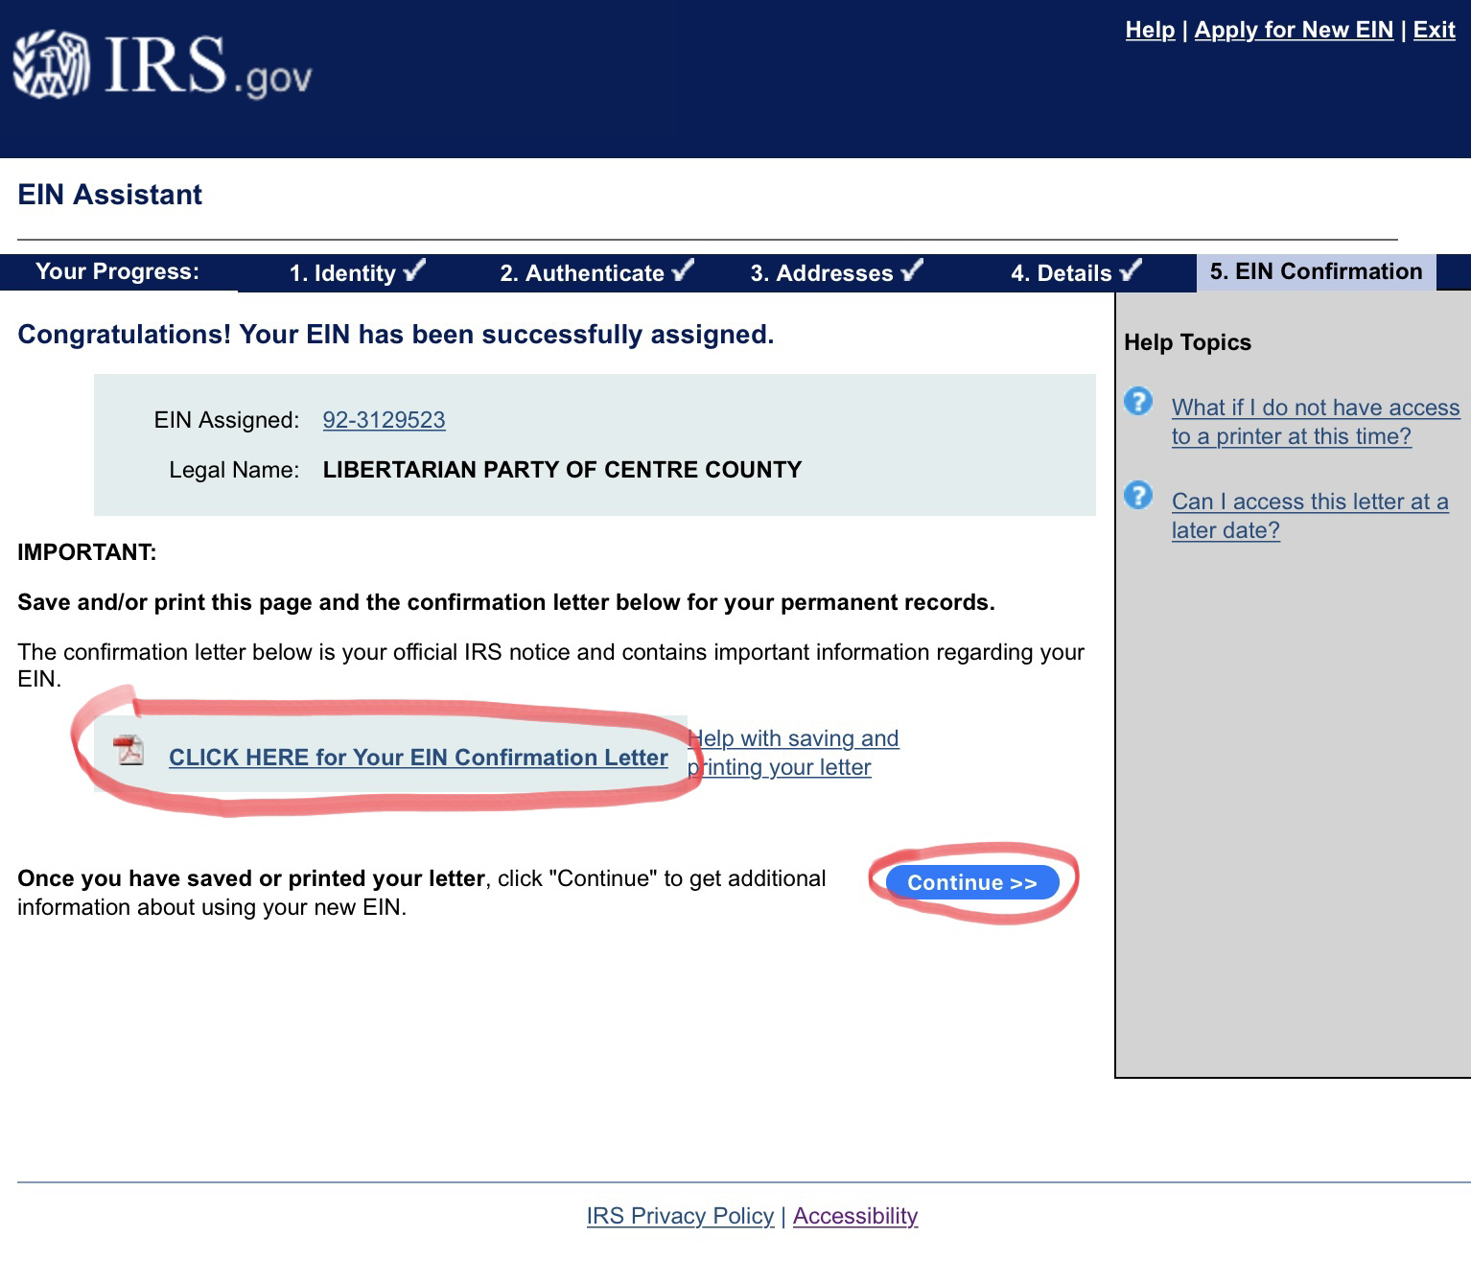
Click CLICK HERE for Your EIN Confirmation Letter
Print and Save PDF Letter
Click Continue

Slide 16
Congratulations!!! Now go make a bank account

